Slide 1
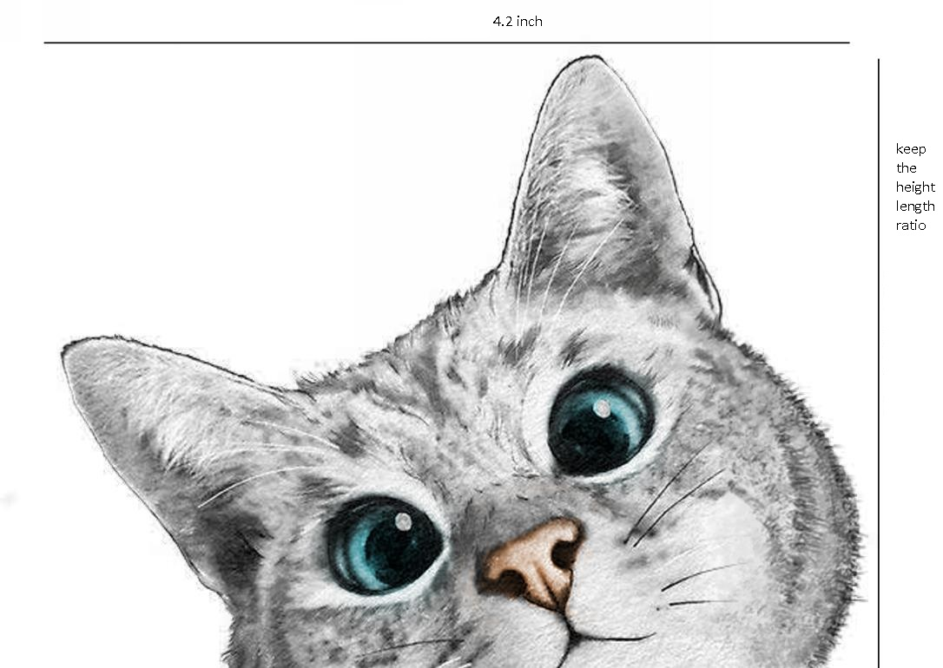
My Design
I want color and design style
to be similar to page 2 and 3

Slide 2
Reference 1 from previous design

Slide 3
Reference 2 from previous design

